Slide 1
Graph-based Movie Recommender System
using Sentiment, Emotion Analysis of BERT
BERT
Graph Neural Network (GNN)
Presenter : Cheonsol Lee
Date : 2021.10.07
Notes:
안녕하세요.
BERT의 감성분석을 활용한 그래프 기반의 영화 추천시스템에 대한 연구를 말씀드리겠습니다.

Slide 2
1
Introduction
2
Related Work
3
Method
INDEX
4
Experiment
5
Results
6
Conclusion

Slide 3
1. Introduction
Thank you

Slide 4


1. Introduction – Motivation
Industry of Recommender System
User experience(UX) is required for personalized marketing.
When watching the movies, UX may be expressed as Sentiment/Emotion data.
Cinematic Experience (CX)
It means an unforgettable experience from watching a film.
User’s psychological information -> Sentiment/Emotion
Rational basis [1]
User’s feelings are reflected in the movie review.
There is a correlation between emotions about the movie reviews and satisfaction.
Emotional information can be used as personalized data.
[1] The impact of emotions on the helpfulness of movie reviews (JART 2015)

Slide 5
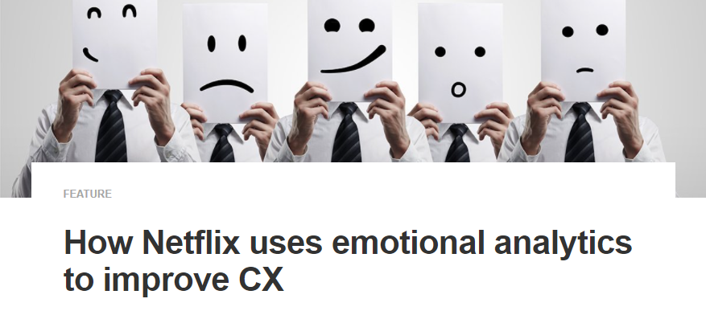

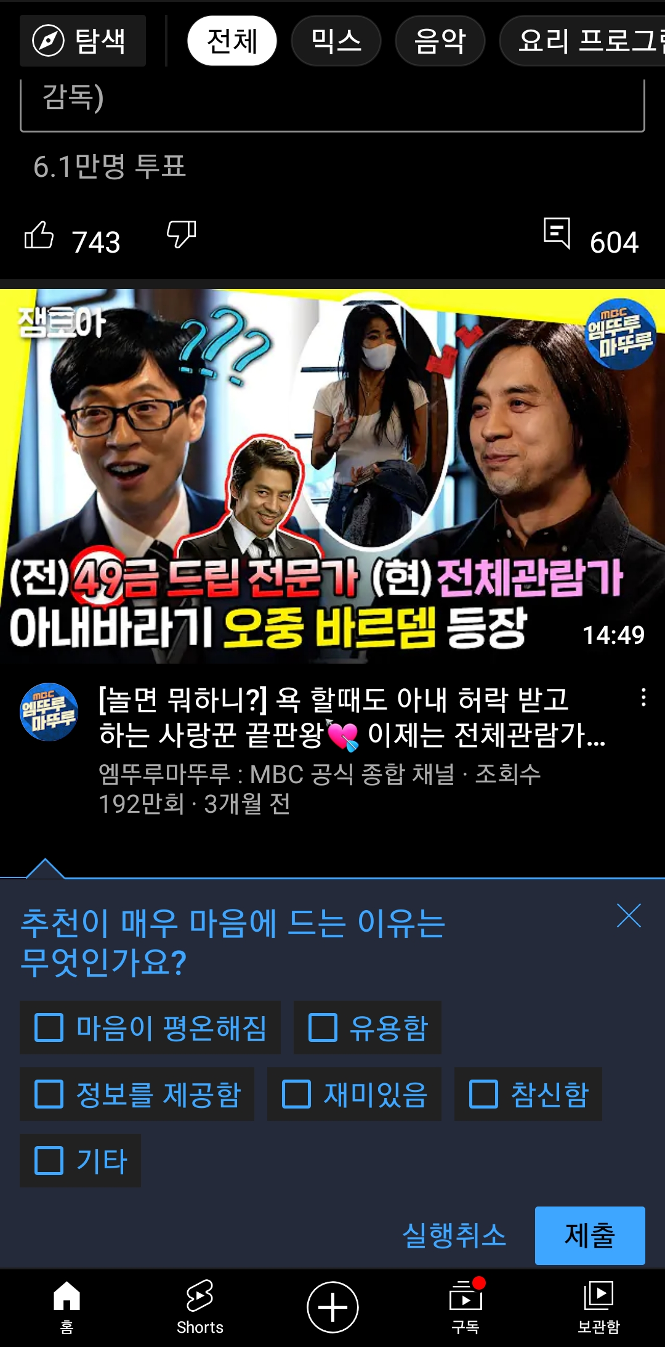
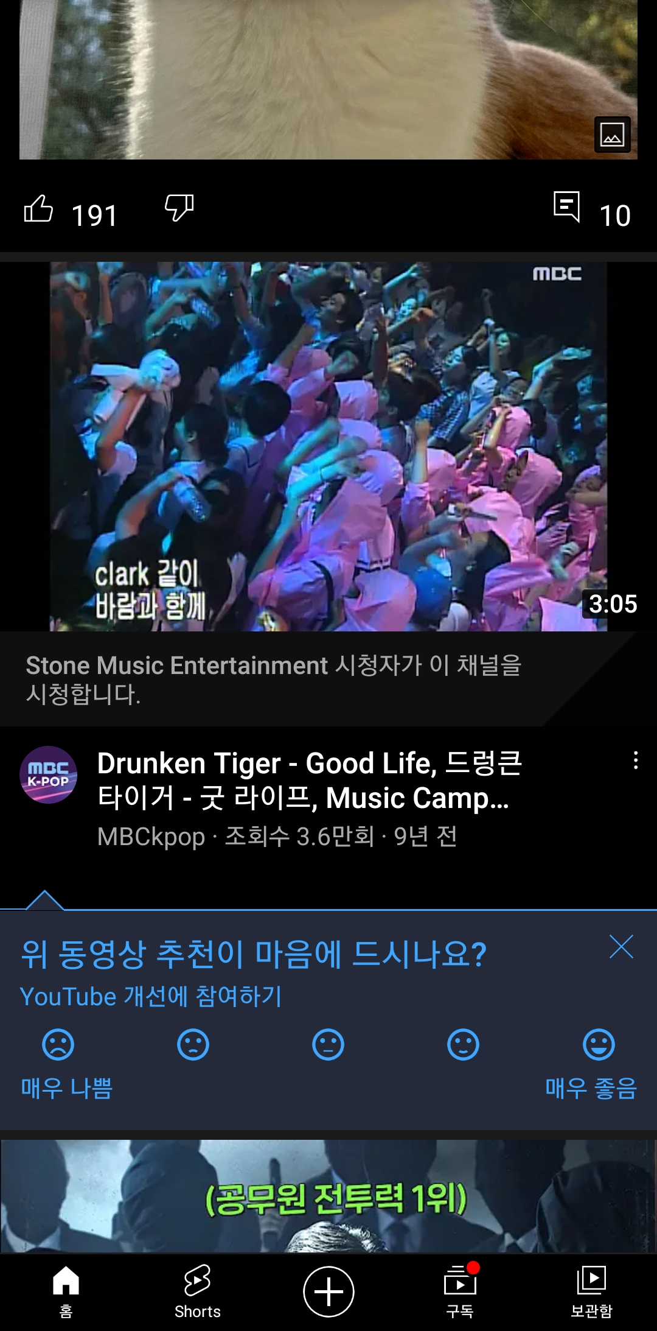

1. Introduction – Industrial Cases
Industrial Cases of Sentiment/Emotion for Personalized Recommendation
Netflix
Emotional analytics to improve CX
Emotional analytics enable businesses to obtain customer feedback.
YouTube
Report : Sentiment(5-levels), Emotion(part level)
<Technical report>
<Sentiment>
<Emotion>

Slide 6
1. Introduction – Research Question(RQ)
RQ1) Is there a performance improvement,
when sentiment is divided into 5-levels and emotion into 6-levels?
RQ2) Which model performs the best rating prediction in recommender system algorithms?
RQ3) Is there a significant difference when sentiment and emotion are reflected in GCMC?

Slide 7
2. Related Work
Thank you

Slide 8
2. Background
Definition
Sentiment divides user’s positive and negative feelings into 5-levels (ordinal)
Emotion divides user’s psychological feelings into 6-levels. (categorical)
0 | 1 | 2 | 3 | 4
Negative | Somewhat Negative | Neutral | Somewhat Positive | Positive
0 | 1 | 2 | 3 | 4 | 5
anger | fear | joy | love | sadness | surprise

Slide 9
2. Related Work (cont’d)
Emotion Analysis
[1] The impact of emotions on the helpfulness of movie reviews (JART 2015)
[2] Tensor-based tag emotion aware recommendation with probabilistic ranking. (KSII 2019)
[3] Item recommendation using tag emotion in social cataloging services. (ScienceDirect 2017)
[4] Using Affective Features from Media Content Metadata for Better Movie Recommendations (KDIR 20’)
Detect movie overviews’ implicit affective features like emotion and sentiment.
Strength: reflect dynamic information like user’s emotion and sentiment
Sentiment Analysis
[5] Review Sentiment-Guided Scalable Deep Recommender System (SIGIR 2018)
[6] How to improve the accuracy of recommendation systems: Combining ratings and review texts sentiment scores. (JIIS 2019)
[7] The impact of emotions on the helpfulness of movie reviews (JART 2015)
There is a correlation between emotions about the movie reviews and satisfaction.
[8] Integrating Collaborative Filtering and Sentiment Analysis : A Rating Inference Approach (ECAI 06’ workshop)
Approach sentiment analysis with statistical techniques
[9] BERT 기반 감성분석을 이용한 추천시스템 (KCI 21')
Comparing Emotional Analysis with ML/DL Techniques and Presenting the Performance of BERT
Limitation : rating inference was only carried out, and explainable recommendation is not possible.
[10] Movie Recommendation System Using Sentiment Analysis From Microblogging Data (IEEE transactions on css 20’)
Hybrid RS from collaborative filtering(CF) and content-based filtering(CBF) along with sentiment analysis

Slide 10
2. Related Work
Graph Neural Network
[10] Graph Convolutional Matrix Completion (KDD 2018)
[11] Community Detection in Multi-Layer Graphs: A Survey (SIGMOD 2015)
[12] Link Prediction Based on Graph Neural Networks (NIPS 2018)
[13] AIRC: Attentive Implicit Relation Recommendation Incorporating Content Information for Bipartite Graphs (MDPI 2020)

Slide 11
3. Method
Thank you

Slide 12
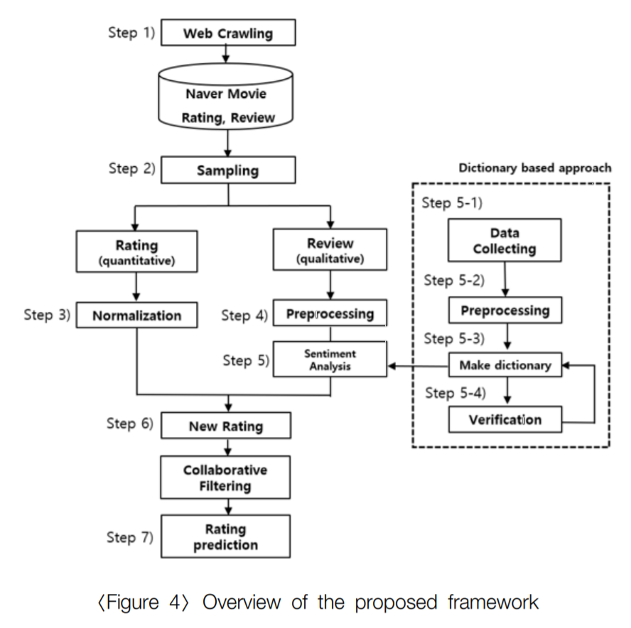
3. Method
Web Crawling
Movie Database
Sampling
Review
Rating
Review
BERT
BERT
Normalization
Sentiment / Emotion
Sentiment
Emotion
Multi-layer graphs
embedding
Graph Model
Rating Prediction

Slide 13
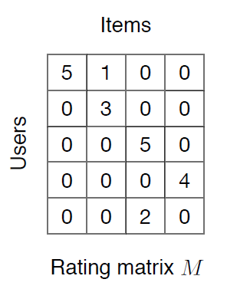
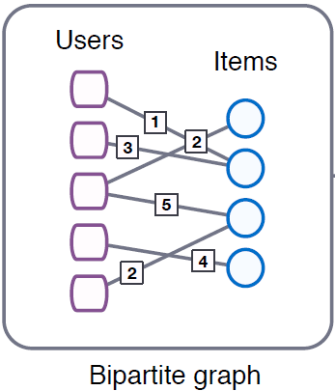
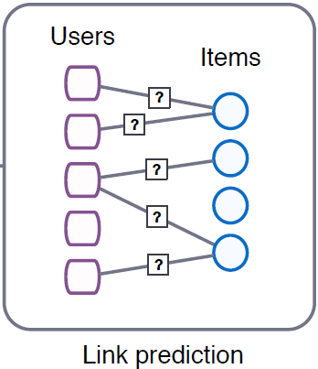
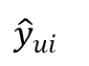
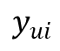
3. Framework – Baseline
User features: top_critic, publisher_name
Item features: title, year, genres
Target
$$y_{ui}$$
User embedding
GCMC
Encoder
GCMC
Decoder
$${\hat{y}}_{ui}$$
Prediction
Item embedding
Notes:
그래프를 단순 합으로 결합
Multi-layer로 구성하여 GNN 학습

Slide 14
3. Framework – Baseline + IDEA concept
Target
$$y_{ui}$$
M | R | U
0 | 3 | 1
1 | 2 | 1
2 | 1 | 2
User embedding
GCMC
Encoder
GCMC
Decoder
$${\hat{y}}_{ui}$$
Prediction
Item embedding
(Rating)
Type1
Type2
Type3
Notes:
그래프를 단순 합으로 결합
Multi-layer로 구성하여 GNN 학습

Slide 15
3. Framework1 – Before Encoding
M | R | U
0 | 3.5 | 1
1 | 4.7 | 1
2 | 1.3 | 2
Target
$$y_{ui}$$
(Rating)
M | R | U
0 | 3 | 1
1 | 2 | 1
2 | 1 | 2
User embedding
GCMC
Encoder
GCMC
Decoder
$${\hat{y}}_{ui}$$
Prediction
Item embedding
(Sentiment)
M | R | U
0 | 5 | 1
1 | 2 | 1
2 | 3 | 2
(Emotion)
Notes:
그래프를 단순 합으로 결합
Multi-layer로 구성하여 GNN 학습

Slide 16
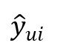
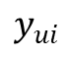
3. Framework2 – After Encoding
M | R | U
0 | 3.5 | 1
1 | 4.7 | 1
2 | 1.3 | 2
User embedding
GCMC
Encoder
Target
Item embedding
$$y_{ui}$$
(Rating)
M | R | U
0 | 3 | 1
1 | 2 | 1
2 | 1 | 2
User embedding
User embedding
GCMC
Encoder
GCMC
Decoder
$${\hat{y}}_{ui}$$
Prediction
Item embedding
Item embedding
(Sentiment)
M | R | U
0 | 5 | 1
1 | 2 | 1
2 | 3 | 2
User embedding
GCMC
Encoder
[Aggregation Functions]
Mean
Sum
Avg
Concat
Item embedding
(Emotion)
Notes:
그래프를 단순 합으로 결합
Multi-layer로 구성하여 GNN 학습

Slide 17
3. Framework3 – After Decoding
M | R | U
0 | 3.5 | 1
1 | 4.7 | 1
2 | 1.3 | 2
User embedding
GCMC
Encoder
GCMC
Decoder
Target
Item embedding
$$y_{ui}$$
(Rating)
M | R | U
0 | 3 | 1
1 | 2 | 1
2 | 1 | 2
User embedding
GCMC
Encoder
GCMC
Decoder
$${\hat{y}}_{ui}$$
Prediction
Item embedding
(Sentiment)
M | R | U
0 | 5 | 1
1 | 2 | 1
2 | 3 | 2
User embedding
GCMC
Encoder
GCMC
Decoder
Item embedding
(Emotion)
Notes:
그래프를 단순 합으로 결합
Multi-layer로 구성하여 GNN 학습

Slide 18
3. Framework4 – Knowledge Distillation
M | R | U
0 | 3.5 | 1
1 | 4.7 | 1
2 | 1.3 | 2
A_{user}
Prediction
GCMC
Encoder
GCMC
Decoder
$${\hat{y}}_{ui}$$
A_{item}
(Rating)
M | R | U
0 | 3 | 1
1 | 2 | 1
2 | 1 | 2
B_{user}
GCMC
Encoder
$$y_{ui}$$
Target
B_{item}
(Sentiment)
M | R | U
0 | 5 | 1
1 | 2 | 1
2 | 3 | 2
C_{user}
GCMC
Encoder
Train Loss : |A-B| + |A-C| + |Prediction-Target|
Testset : only rating dataset (Cover: rating O, review X)
C_{item}
(Emotion)
Notes:
그래프를 단순 합으로 결합
Multi-layer로 구성하여 GNN 학습

Slide 19
3. Framework5 – Features Embedding
Target
$$y_{ui}$$
M | R | U
0 | 3 | 1
1 | 2 | 1
2 | 1 | 2
User embedding
GCMC
Encoder
GCMC
Decoder
$${\hat{y}}_{ui}$$
Prediction
Item embedding
(Rating)
1 | 0 | 0 | 0 | … | 1
0 | 1 | 0 | 0 | … | 0
1 | 0 | 0 | 0 | … | 0
1 | 0 | 0 | 1 | … | 1
0 | 0 | 0 | 0 | … | 1
User features: top_critic, publisher_name
Item features: title, year, genres
Sentiment
Emotion
Sparse Matrix
Notes:
그래프를 단순 합으로 결합
Multi-layer로 구성하여 GNN 학습

Slide 20
4. Experiment
Thank you

Slide 21
4. Experiment – dataset (Movie)
Dataset
Period : 1914.06.01 ~ 2020.10.31
Link : https://www.kaggle.com/stefanoleone992/rotten-tomatoes-movies-and-critic-reviews-dataset
Data
File name | Dimension | Columns
Movie data | (17713, 22) | 'rotten_tomatoes_link', 'movie_title', 'movie_info', 'critics_consensus', 'content_rating', 'genres', 'directors', 'authors', 'actors', 'original_release_date', 'streaming_release_date', 'runtime', 'production_company', 'tomatometer_status', 'tomatometer_rating', 'tomatometer_count', 'audience_status', 'audience_rating', 'audience_count', 'tomatometer_top_critics_count', 'tomatometer_fresh_critics_count', 'tomatometer_rotten_critics_count'
Review data | (1048576, 8) | rotten_tomatoes_link, critic_name, top_critic, publisher_name, review_type, review_score, review_date, review_content
Rating | Review | Amount | Rate
O | O | 758,709 | 67%
X | O | 305,502 | 27%
O | X | 65,372 | 5%
X | X | 434 | 0.03%

Slide 22
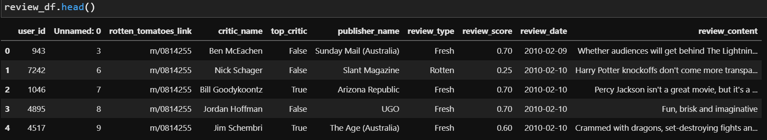
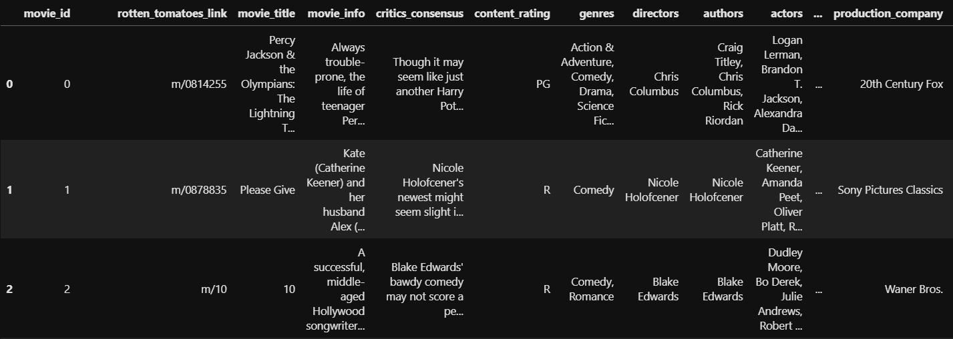
4. Experiment – dataset (Movie)
Dataset
Rating matrix
Group : critic_name, top_critic, publisher_name
The number of users : 9,794
Movie matrix
The number of movies: 17,614

Slide 23
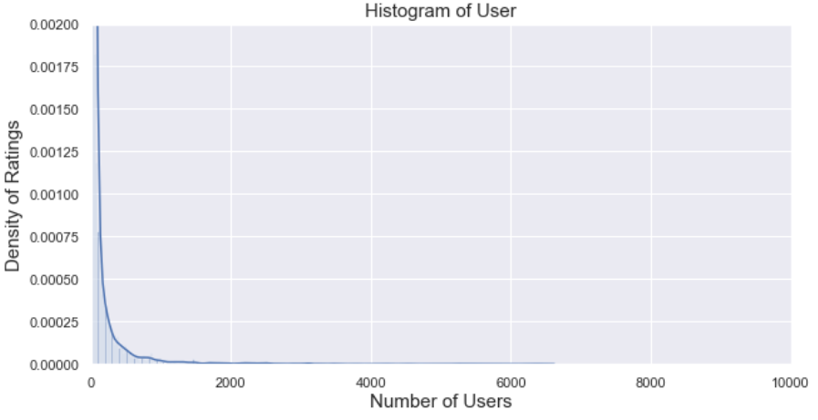
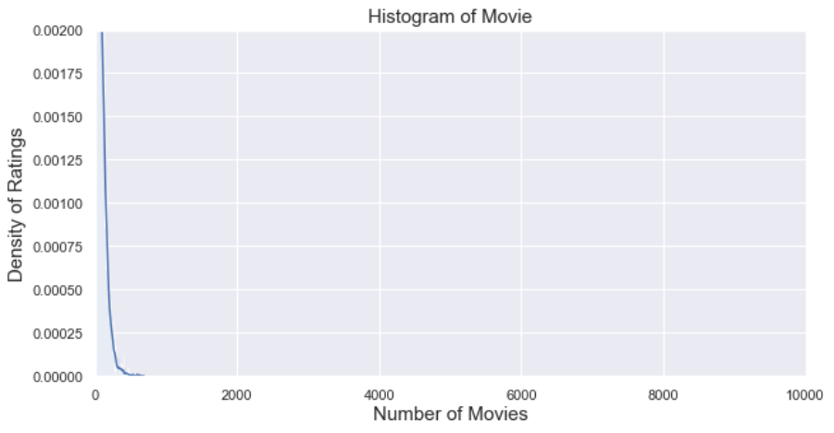
4. Experiment – dataset (Movie)
Histogram
Group: User, Movie
Train/test rate = 9 : 1 (by timestamp)
Number: user_id(850), movie_id(6,805)
Exclude cold-start problem (user, item)
Range | User | Movie
Total | 9,794 | 17,614
< 3 | 3,552 (36%) | 993 (6%)
< 5 | 4,653 (48%) | 2,892 (16%)
>= 20 | 2,994 (31%) | 8,110 (46%)
>= 500 | 345 (4%) | 13 (0%)
Reviews >= 20
<User>
<Movie>

Slide 24
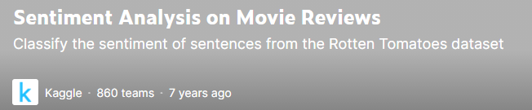
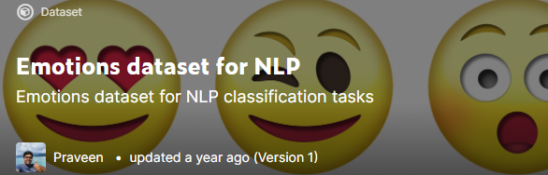
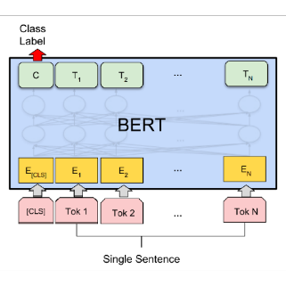
4. Experiment – dataset (sentiment, emotion)
Sentiment, Emotion dataset
Training data for BERT model in Kaggle
Sentiment
Emotion
Training process of BERT
0 | 1 | 2 | 3 | 4
Negative | Somewhat Negative | Neutral | Somewhat Positive | Positive
0 | 1 | 2 | 3 | 4 | 5
anger | fear | joy | love | sadness | surprise
Review data
Result
U | E | M
0 | 1 | 1
1 | 3 | 1
2 | 2 | 2
Uma Thurman as Medusa, the gorgon with a coiffure of writhing snakes and stone-inducing hypnotic gaze is one of the highlights of this bewitching fantasy
Sentiment, emotion value
(graph)

Slide 25
4. Experiment – Table
Result
Graph type : Rating, Sentiment, Emotion + Meta informaion
Data : 60% (rating, review)
Ideal result
Type | Method | RMSE/MAE | Data
Baselines | CF MF: SVD, SVD++ | Low | Rating
Graph (in general) | GCMC | Middle | Rating
Graph (our model) | GCMC + “novelty” | High | Rating
 |  |  | Rating + Sentiment
 |  |  | Rating + Emotion
 |  |  | Rating + Sentiment + Emotion

Slide 26
5. Results
Thank you

Slide 27
5. Results – Table
16 Experiments
Algorithm | RMSE | RANK
SVD | 0.8469 | 5
SVDpp | 0.8270 | 4
SlopeOne | 0.9273 | 13
NMF | 0.9056 | 9
NormalPredictor | 1.4758 | 16
KNNBasic | 0.8726 | 8
KNNBaseline | 0.8519 | 7
KNNWithMeans | 0.9232 | 12
KNNWithZScore | 0.9168 | 11
BaselineOnly | 0.8485 | 6
CoClustering | 0.9538 | 14
GCMC(Feature X) - regression | 0.9637 | 15
GCMC(Feature O) - regression | 0.9148 | 10
GCMC(Feature X) | 0.8142 | 3
GCMC(Feature O) | 0.7176 | 2
GCMC(Feature O, T=0.8) | 0.7127 | 1
Surprise
GCMC

Slide 28
5. Results – RMSE Graph

Slide 29
6. Conclusion
Thank you

Slide 30
6. Conclusion
Cinematic Experience(CX) can be used for personalized recommendations.(진행중)
The graph reflects the relational information between users and items.
GNN-based recommendation is better than traditional methods.
Recommendations reflecting sentiment/emotion data improve rating prediction. (진행중)

Slide 31
Thank you
Thank you

Slide 32
Appendix
Thank you

Slide 33
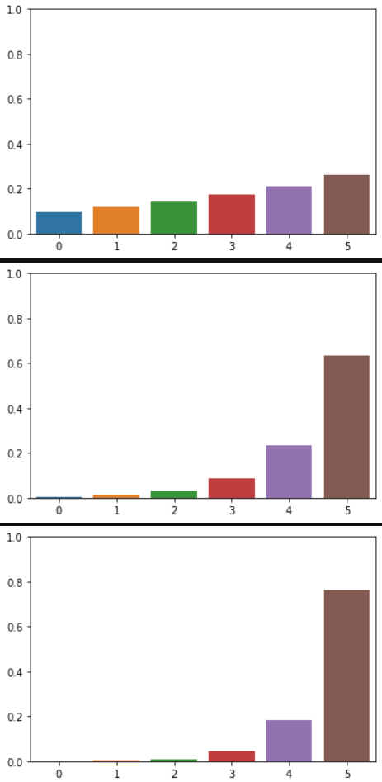
4. Experimental Table
Temperature Scaling
Calibration : changes the distribution of rating
T = 5.0
T = 1.0
T = 0.8

Slide 34
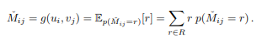
Score
GCMC 점수 계산
Regression으로 계산 후 rmse로 score 계산
Ex) (1*0.1) + (2*0.2) + (3*0.3) + (4*0.1) + (5*0.3) = 3.3

Slide 35


3. Framework - Methodology
M | R | U
0 | 0.5 | 1
1 | 0.7 | 1
2 | 0.3 | 2
Sum of relation values
Multi-layer Graph
(Rating graph)
M | S | U
0 | 1 | 1
1 | 3 | 1
2 | 2 | 2
Graph
model
(Sentiment graph)
[Predicted Rating]
Metric: RMSE/MAE
[Baseline]
Traditional: CF, SVD, NCF
Graph: NGCF, GCN, GAT, GraphSAGE
M | B | U
0 | 1 | 1
1 | 2 | 1
2 | 5 | 2
Ablation Study
(Emotion graph)
Notes:
그래프를 단순 합으로 결합
Multi-layer로 구성하여 GNN 학습

Slide 36
3. Result Table
Result
Graph type : Rating, Sentiment, Emotion
Data : 60%(rating, review)
Ideal result
Type | Method | F1-score | Data
Baselines | CF MF FM NCF | Low | Rating
Graph (in general) | GCN (GCMC) GAT GraphSAGE Graphormer | Middle | Rating
Graph (our model) | GNN + “novelty” | High | Rating
 |  |  | Rating + Sentiment
 |  |  | Rating + Emotion
 |  |  | Rating + Sentiment + Emotion

Slide 37
1. Introduction – Research Question(RQ)
RQ1) How do you define Movie Experience(MX)?
Use sentiment/emotion as additional information that can’t be included in rating
RQ2) How do you express MX?
3 types of graphs : rating, sentiment, emotion
The graph reflects the relational information between users and items.
RQ3) Which model performs the best rating prediction?
GNN-based model : GCMC, IGMC, IMC-GAE

Slide 38
4. GNN
GNN Model
Graph Convolutional Matrix Completion (GCMC) [KDD 2018] (세팅 완료, 데이터 적용 중)
Inductive Matrix Completion Based on Graph Neural Networks (IGMC) [ICLR 2020] (예정)
Inductive Matrix Completion Using Graph Autoencoder (IMC-GAE) [CIKM 2021] (세팅 완료, 데이터 적용 중)

Slide 39
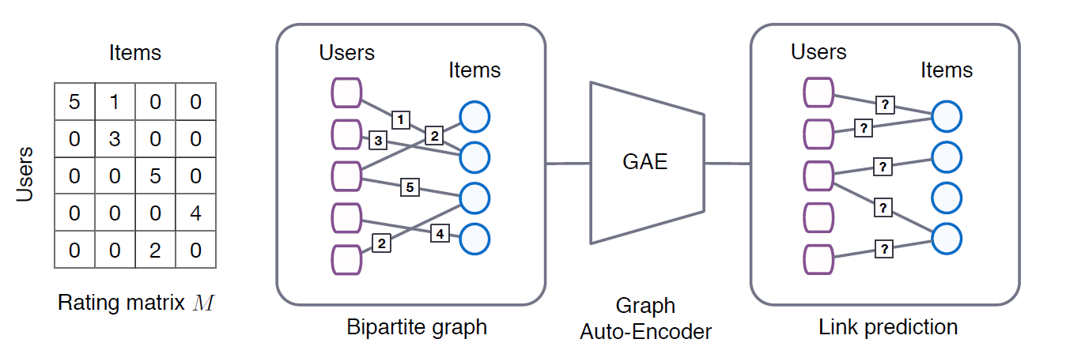
4. GCMC
Graph Convolutional Matrix Completion [KDD 2018]
Rating
Node features
GCN

Slide 40
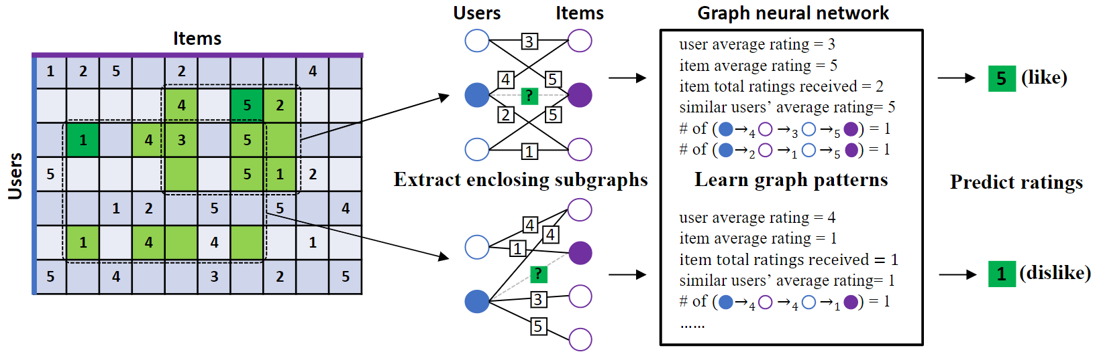
4. IGMC
Inductive Matrix Completion Based on Graph Neural Networks (IGMC) [ICLR 2020]
Rating

Slide 41
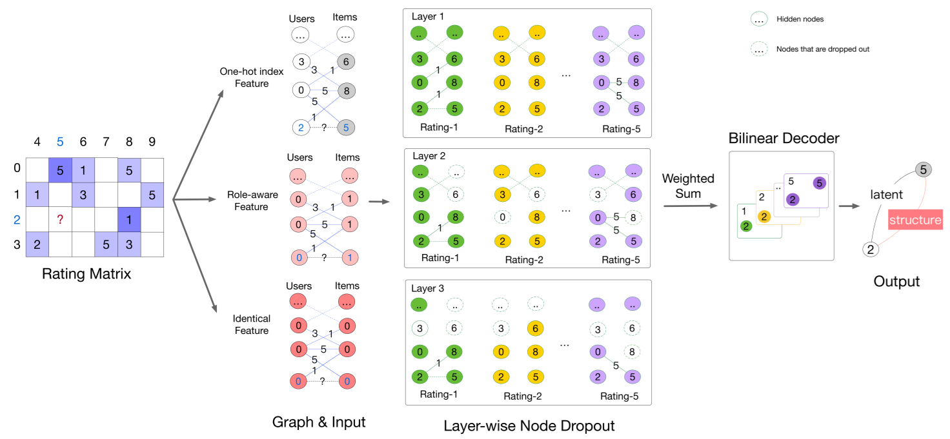
4. IMC-GAE
Inductive Matrix Completion Using Graph Autoencoder (IMC-GAE) [CIKM 2021]
Rating

